Slide 1
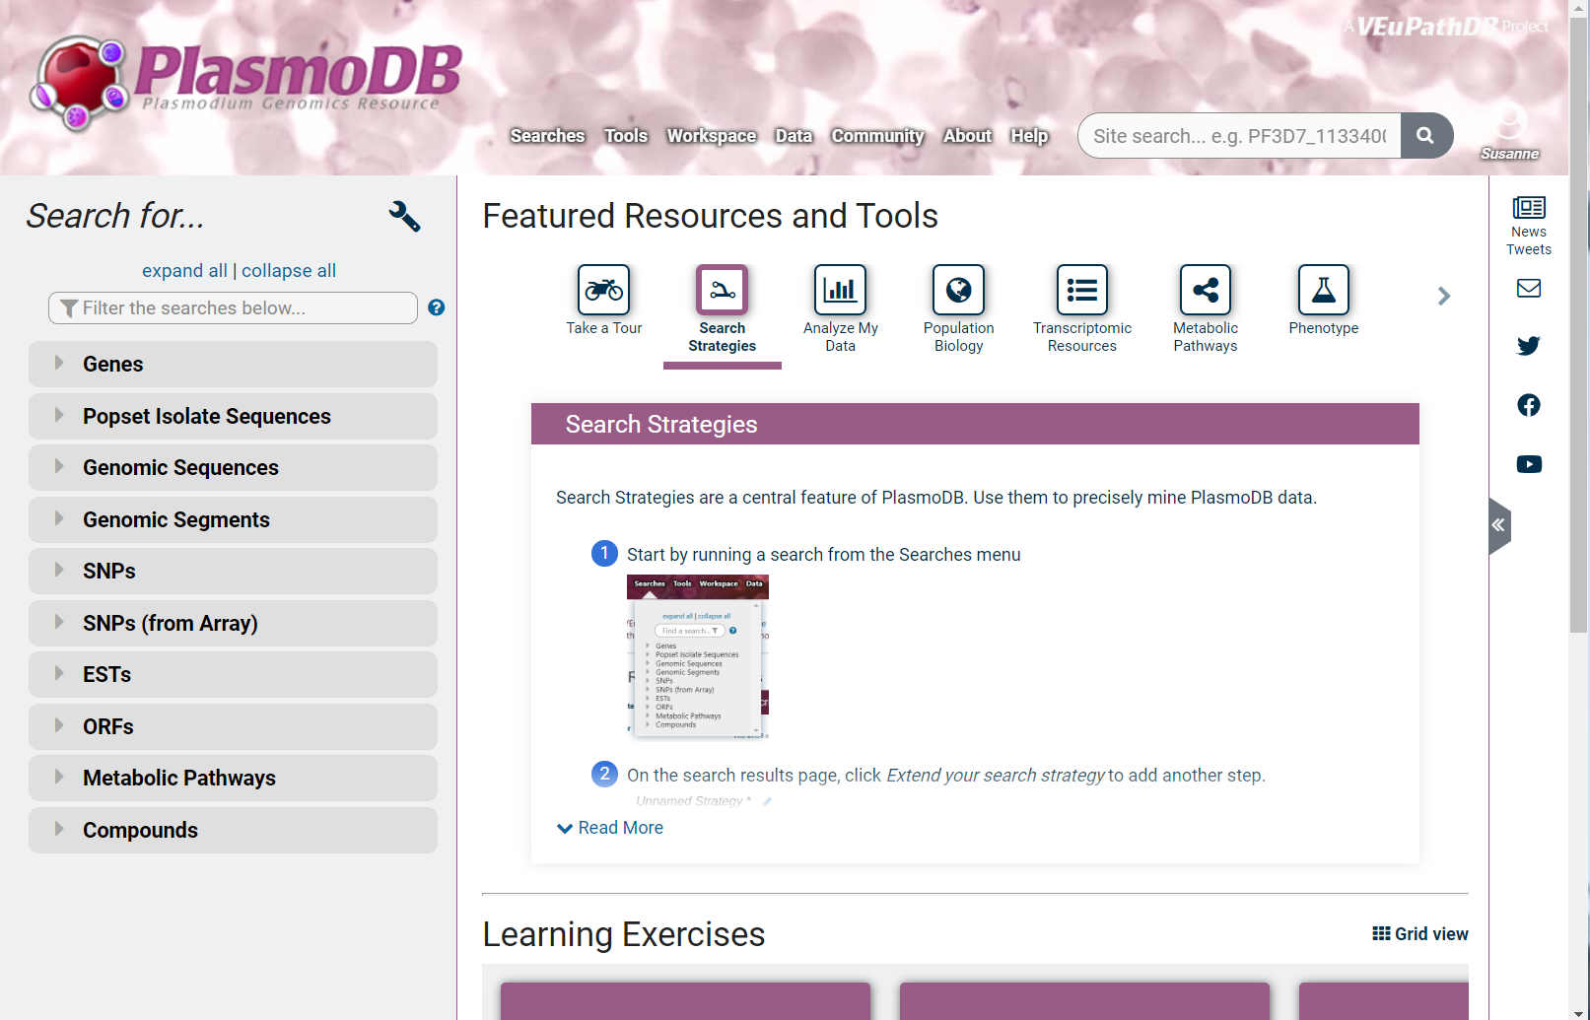
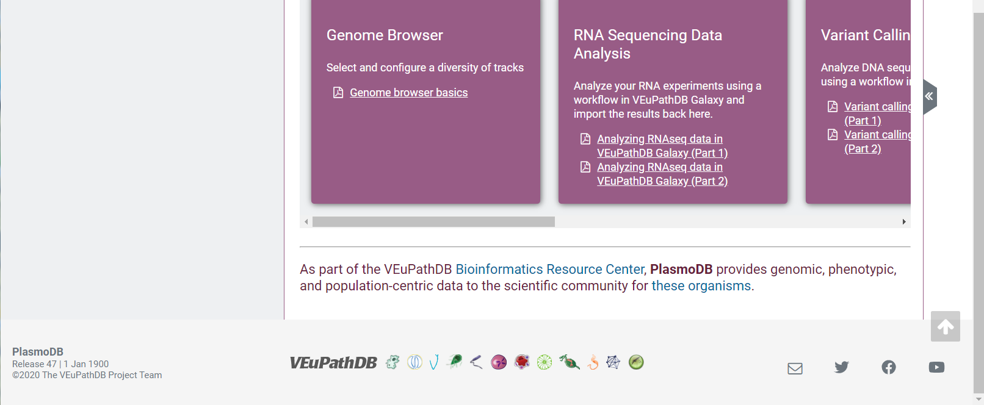

Slide 2
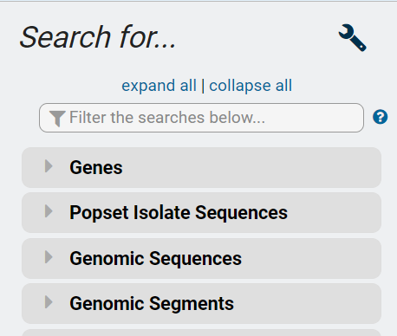

Slide 3
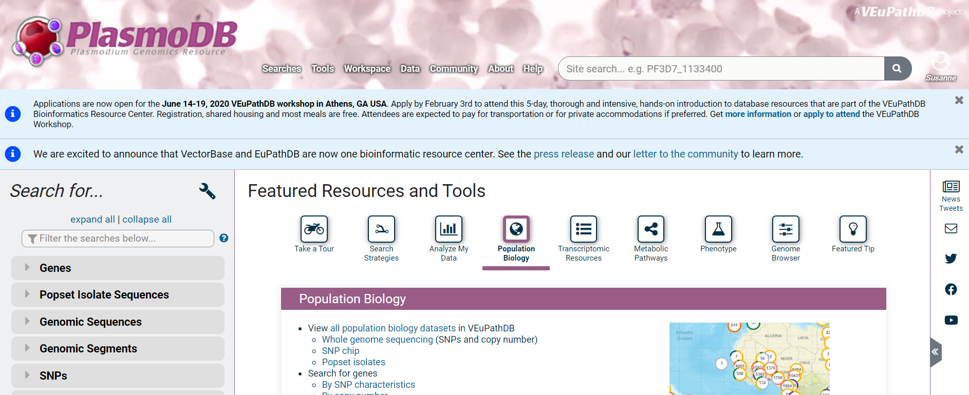
Site search:
Enter a gene ID to navigate to its record page. Or enter a text term to find the term anywhere on the site and see an interactive summary of the term's occurrence per record type on our site.
Search Filter:
This tool helps you navigate the tree below which contains links to our searches that query pre-analyzed omics data.

Slide 4
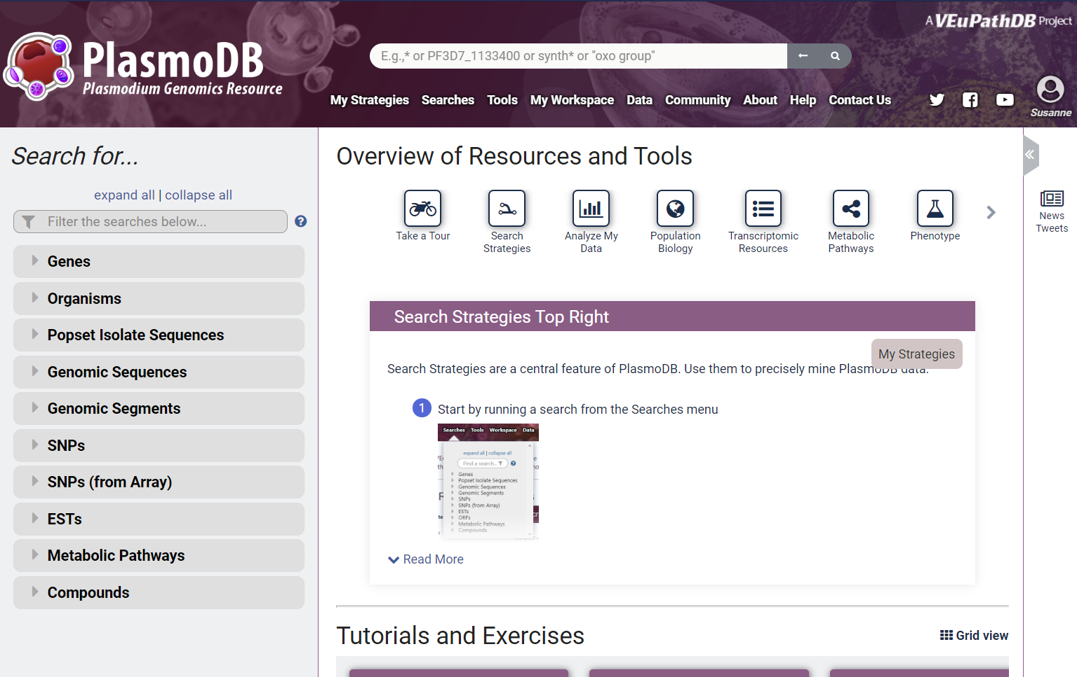

Slide 5
Filter for search categories
Site Search

Slide 6
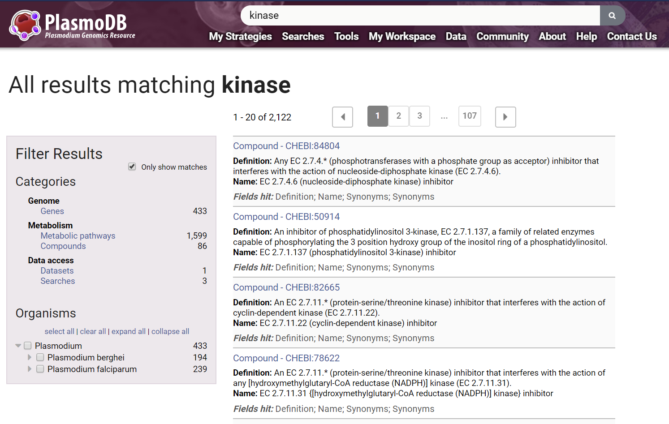
Categorized results
Individual matches

Slide 7
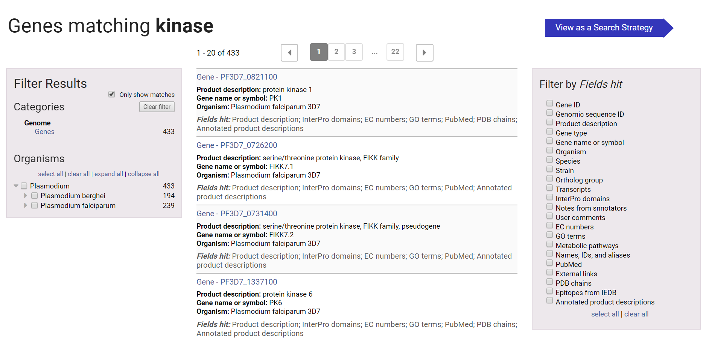
Categorized results
Individual matches
Filter matches and send to strategies

